Slide 1

OM 420/620 Predictive Business Analytics Team Project Tips Grocery Data

Slide 2
Background
You have just been hired as an analyst for an undisclosed grocery store
Data: grocery.accdb
Data dictionary

Slide 3
Grocery Data
Transaction data: transactionsT
One row per scan
In the data, sales and cost are the total sales and the total cost of the transaction
And others
customersT
subdeptsT
deptsT
specialsT

Slide 4
Defining the Business Objective
Your prediction problem should be
predicting something not so obvious
Ex. Predicting the profit in May based on sales and total cost in May – there is nothing to predict
useful to the grocery store
When you define a prediction problem, you should also think about whether you can derive input attributes that would help your prediction. You should be able to compute them from our data.

Slide 5
Defining the Business Objective
Imagine how the grocery store would use your prediction model
Pay attention to the prediction timing: the input attributes should come from data that are available at the prediction timing
Ex. If you are predicting something in May based on April data, then the prediction timing is the end of April. In your analysis, the input attributes come from April and the target attribute comes from May. When the grocery store uses your model in practice, they have only April data.
Setting up an objective takes effort and time

Slide 6
Note about the Data
We do not have much information about personal characteristics of customers
However, we know a lot about their purchasing patterns
This is often the case in applications other than retail as well, such as healthcare
Setting up the data for the Goal 2
each row should be an entity of interest
Ex. If you are predicting something for each customer, then the table should be aggregated at the customer level (you can use GROUP BY)
each column should be an attribute of the entity of interest

Slide 7
SQL and R:
SQL is better for aggregating records and linking tables
It is better to use R for data cleaning, exploratory analysis, and model building
Data cleaning is often specific to your goal
Do not forget validation
It is also interesting to analyze class 0/1 error rates
Read the project description carefully
In particular, designate two findings you are reporting

Slide 8
Data Types and Models
Can the models we learned handle categorical input attributes?
KNN
You can turn categorical variables into numbers so that KNN can handle them
But you should think if Euclidean distance between observations makes sense
LDA: the model assumes normal distributions for features, so no
Decision tree, boosted trees, random forest: no problem

Slide 9
Data Types and Models
Can the models predict a target attribute in any type?
KNN can predict any data type
LDA can predict only categorical variable
Decision trees and other related models can predict any data type

Slide 10
Predicting Rare Events
Predicting a rare event is hard
For binary classification, as the percentage of ‘Yes’ gets close to zero, it generally becomes harder
If the percentage of ‘Yes’ is 5%, then a trivial predictor predicting ‘No’ always is 95% accurate
Thus, it is recommended to compute the percentage of the event you are predicting

Slide 11
I put a minimal weight on the prediction accuracy, but you should demonstrate your effort to improve it
Using one of those examples is okay
Your analysis in the write-up may be different from that of your presentation

Slide 12
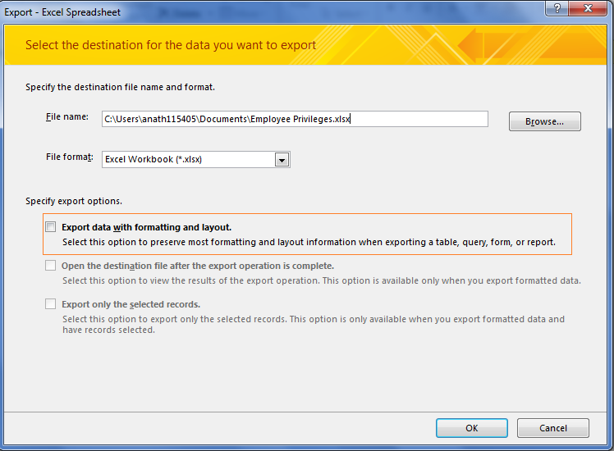
Exporting more than 65K rows
When you export a table from MS Access to a file, if it has more than 65k rows, then you should uncheck the option 'Export data with formatting and layout'

Slide 13
SQL Tip
After choosing an entity of interest, you can create a table of the entities with multiple attributes using a keyword IIF
For example: obtaining the total grocery sales of each customer
SELECT customer_id, SUM(IIF(sub_department in (1), sales_value, NULL)) AS total_grocery_sales
FROM transactionsT
GROUP BY customer_id;

Slide 14
SQL Tip
You can also generate categorical variables about whether a basket includes a certain item or not:
SELECT till_receipt_number,
IIF(SUM(IIF(sub_department in (1), sales_value, NULL))>0, 'grocery',NULL) AS grocery,
IIF(SUM(IIF(sub_department in (3,33), sales_value, NULL))>0,'dairy',NULL) AS dairy,
IIF(SUM(IIF(sub_department in (78,79), sales_value, NULL))>0,'tobacco',NULL) AS tobacco
FROM transactionsT
GROUP BY till_receipt_number;

Slide 15
SQL Tip
You can run two joins at once as follows:
SELECT transaction_id, customersT.customer_id, customersT.cu_age_range, subdeptsT.subdepartment_id,subdepartment_description
FROM (
transactionsT INNER JOIN customersT
ON transactionsT.customer_id=customersT.customer_id
)
INNER JOIN subdeptsT
ON transactionsT.sub_department = subdeptsT.subdepartment_id;

Slide 16
The following slides review some materials that we learned and are important for the team project.

Slide 17
What Is Data Mining?
Data mining is a process of data-driven extraction of not so obvious but useful information from large databases
Data is a set of facts/observations/measurements about objects/events/processes of interest
Information is processed data that is useful in one way or the other, for example for decision making, communication etc. - while the data is fixed, information from it can differ based on needs

Slide 18
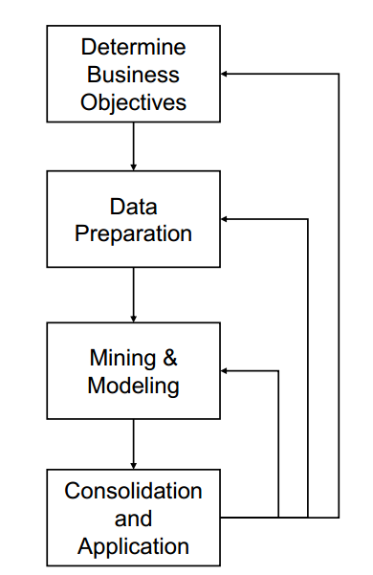
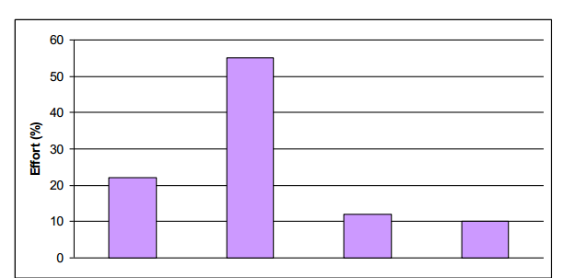
Effort in Data Mining
?
?
?
?

Slide 19
Supervised & Unsupervised Learning
Supervised Learning: Learning with a teacher
We have a target attribute of interest (e.g., default or not)
The goal is mostly to predict the target attribute
Categorical prediction (classification)
Numeric prediction (regression)
Unsupervised Learning: Learning without a teacher
No target attribute
The goal is to explore data to find valuable information
Cluster Analysis
Association Rules

Slide 20
The Input for Supervised Learning
Attributes/Features/Predictors/Input Variables/Independent Variables
Target Attribute
/Output Variable
/Dependent Variable
Cases
or
Instances
or
Observations
or
Records
or
Objects
...
...
...
...
...
...
...
...
For example, fraud or not
...
.
.
.
.
.
.
.
.
.
.
.
.
.
.
.
.
.
.
.
.
.
.
.
.
.
.
.
.
.
.
.
.
.
...
For example, income, education, past transactions, …

Slide 21
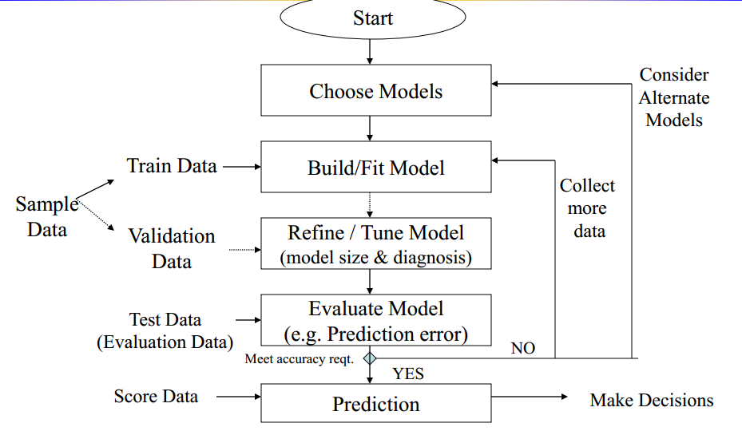
Mining & Modeling Process Flowchart

